Slide 1


Proposal
Writing

Slide 2
Objectives
1
How to make multiple types of proposals and when to use them
What to include and exclude in proposals
Examples of proposals

Slide 3
Proposal Types
2
Casual
Semi-Formal
Complex/Formal

Slide 4
3
Casual
1) Quick and easy
2) For small projects
3) For clients you’ve worked before

Slide 5

3
Casual - How?
You give estimation and then a range of information.
Problem Statement (Define The Problem)
Proposed Solution (Propose The Solution)
Pricing Information (Provide Costs To Fix Problems)
Next Step(s) (Create a Call To Action)
The aesthetics aren't as important
Make sure you answer questions
It can be strategic

Slide 6
3
Casual - Practice
Write a casual proposal to the potential client

Slide 7
4
Semi-Formal
You give an overview in email and attached to that, you give a deeper estimate. You combine an oversight in email with technical details attached.

Slide 8
4
Semi-Formal
In Email:
1) State your purpose. Do this clearly and concisely so that the reader knows immediately why you are writing.
2) Give some background information about the project you are responding too and what is the “problem”
3) State a solution to the problem; this is where you give specifics about your suggestion. Also add your insight and perceptions on the problem and solution
4) Continue with any costs that will be involved.
5) Give a timeline
Attached:
Give a cost breakdown
Give a detailed timeline
Give specifications of what you will create

Slide 9
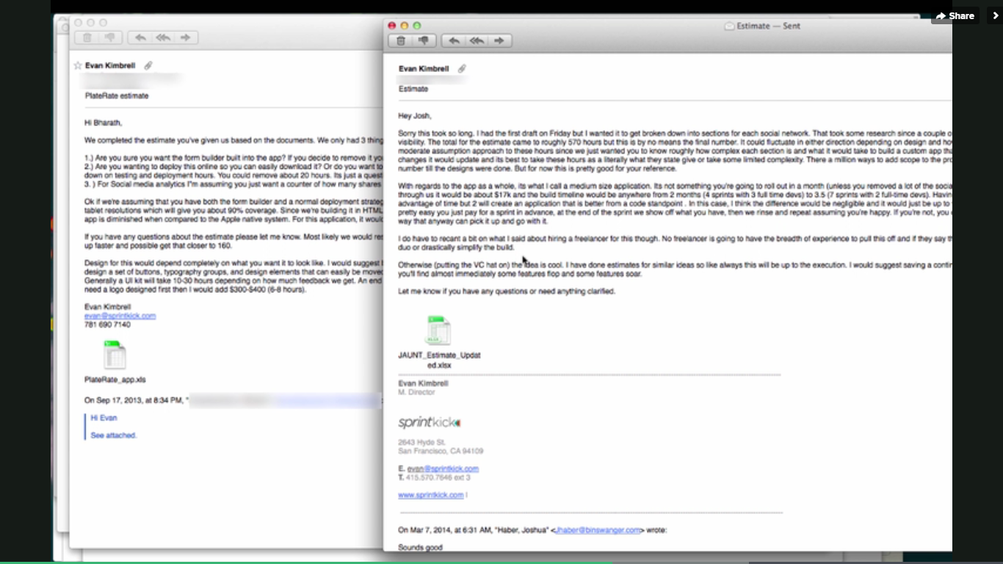
4
Semi-Formal- example

Slide 10
4
Formal
Large, complex projects or medium one that is worth it
For multiple people

Slide 11
4
Formal- How
About you
2) Overview of the project
3) How you work
4) Timeline
5) Price
6) Next steps
7) Disclaimers
OPTIONAL: case studies, contract

Slide 12
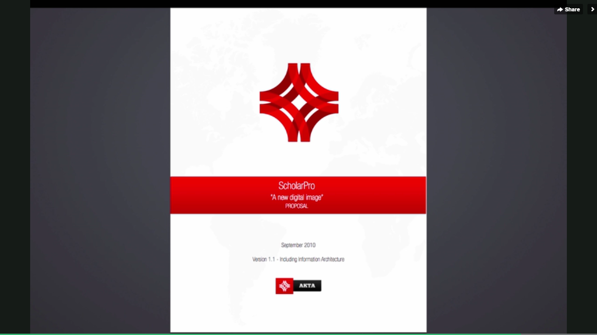
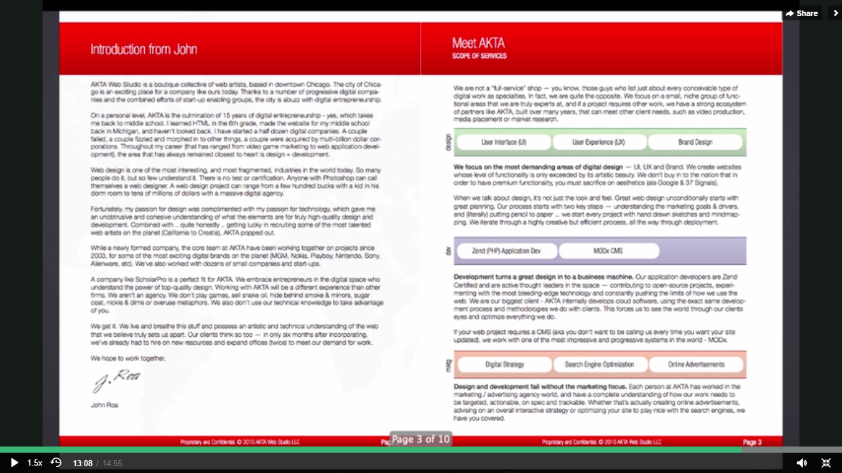
4
Formal - Example

Slide 13
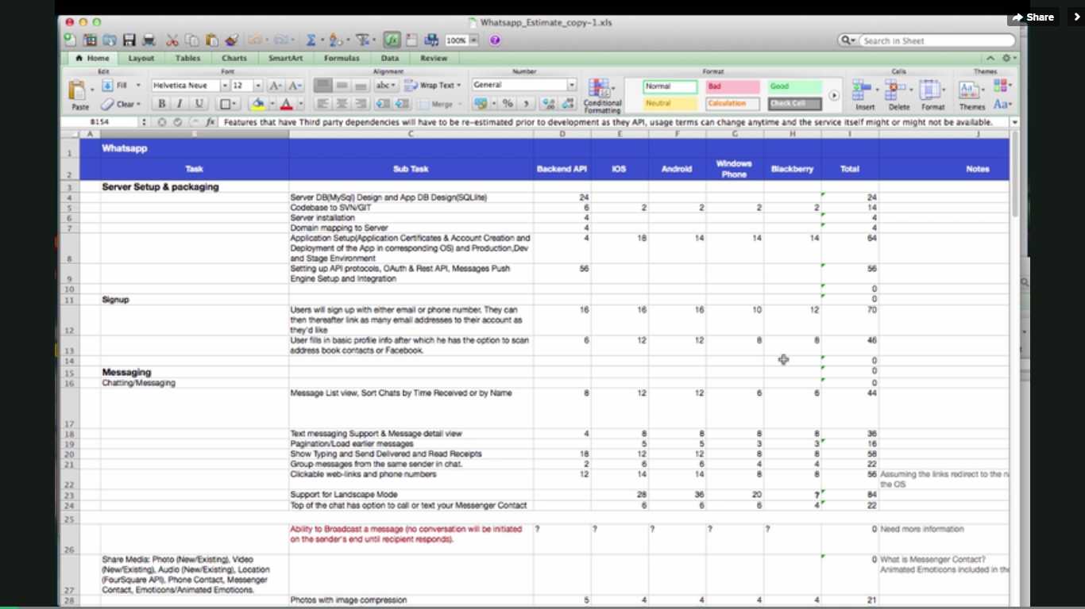

Slide 14
THINK CLIENT

Slide 15
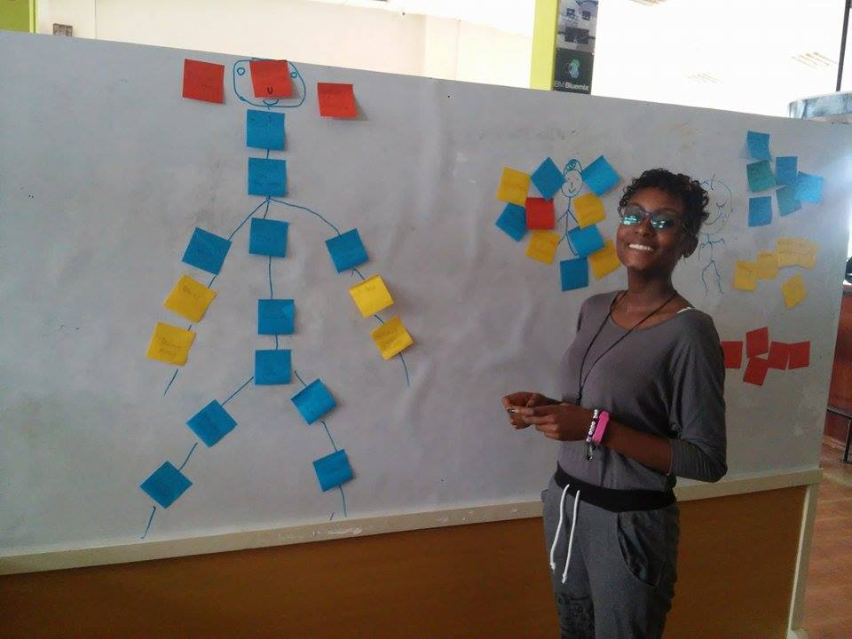
Yusudi is a social enterprise bridging the skills gap between young people and labor market.
We support youth between the age of 18 to 25 in developing their entrepreneurial skills to become more employable in today’s job market or pursue self-employability.
More about Yusudi and how to join:
www.yusudi.co
Yusudi in FB
Events to join

Slide 16
5
Tips
Web-proposal: Proposify.biz, Nusii etc.
2) Customization: 60/40 rule
4) Estimation:
- all together
- section by section
- piece by piece

